Slide 1


Build a Better Blog

Slide 2

External Communication tips
Treat your visitors like wild animals - they're hunting for something.
Put the most important information first
Don't be cute or clever
Make external communication stupidly easy to read.
Notes:
Treat your visitors like wild animals - they're hunting for something. Make it easy for them to find it. - Make source code easy to find on blog posts, and Contact information easy to find on landing pages
Put the most important information first.
Don't be cute or clever - We can be funny and cute other places, but your readers are looking for something. They want information, and they don't want to have to think their way through a riddle
Make external communication stupidly easy to read. - this is actually really hard to do. Marketing people are the best at this.

Slide 3

Content Development and Blog Strategy

Slide 4
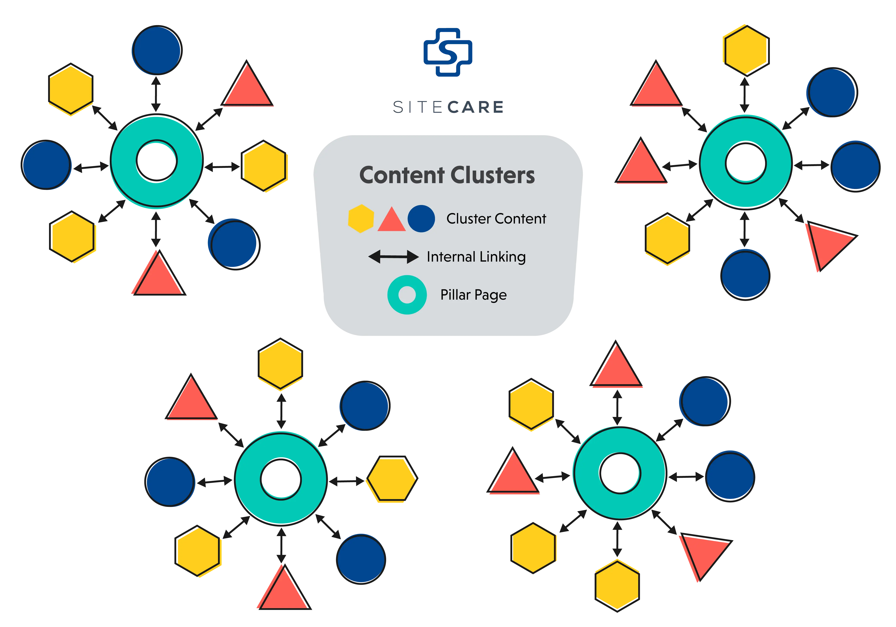

Slide 5
Blog Checklist
Use the primary keyword in the headline. Go back to your headline and make sure the primary keyword is used in the title.
Write 300+ words. Write as much as you need to fully cover the topic, and as a best practice, write more than 300 words to show search engines that it is a thorough resource.
Add value. As you write your post, provide details, facts, stats, takeaways, news, and information that are valuable and helpful to the reader.
Show, don’t tell. An important part of this checklist for blog writing is using examples that help audiences deeply understand and absorb the message you are trying to share.
Notes:
Treat your visitors like wild animals - they're hunting for something. Make it easy for them to find it. - Make source code easy to find on blog posts, and Contact information easy to find on landing pages
Put the most important information first.
Don't be cute or clever - We can be funny and cute other places, but your readers are looking for something. They want information, and they don't want to have to think their way through a riddle
Make external communication stupidly easy to read. - this is actually really hard to do. Marketing people are the best at this.

Slide 6

External Coms cheatsheet
Use short paragraphs – four sentences max
Use short sentences – twelve on average
Skip unnecessary words
Avoid jargon
Avoid the passive tense
Avoid needless repetition
Address your web visitors directly—use the word you
Shorten your text

Slide 7

KEYWORDS
Creative Minds. Smart Execution.

Slide 8
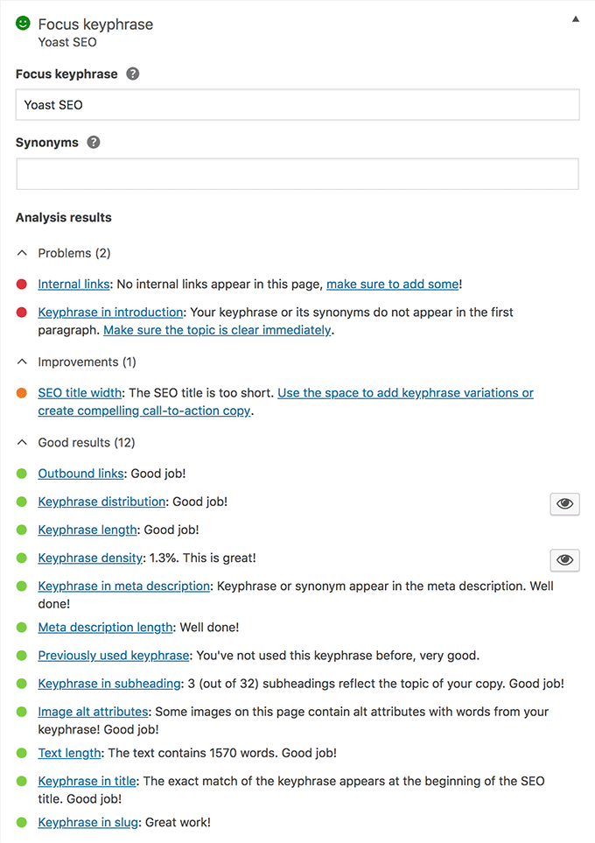




Intro to SEO
1. Website Optimization
Crawl
Mobile
Index
Speed
Tech
Hierarchy
YOAST →
Creative Minds. Smart Execution.

Slide 9

SEO Action Plan
1
2
3
4
Replace existing keywords. Essentially write to the way people are searching
Create a landing page dedicated to each keyword phrase, leveraging a marketing automation platform. Strong calls to action and basket analysis
Write content – blog posts and case studies – with these keywords in varying long tail format
Optimize Meta Descriptions
Creative Minds. Smart Execution.

Slide 10
SEO Action Plan
5
6
7
Work to build backlinks
Repeat this process to build other buckets of keywords – consulting, cloud migrations, DBA ops etc.
Add the SEO keywords to Google Console. Continue to refine and optimize.
Creative Minds. Smart Execution.

Slide 11
Keep your eye on the prize
Google Search Console: https://search.google.com/search-cons...
Google Search Console tells you how you’re ranking on Google. It give you overall site ranking, plus ranking for your keywords
Adding and verifying your site in Search Console proves to Google that you're either a site's owner, webmaster, or other authorized user. After all, Search Console provides you with all sorts of incredibly detailed information and insights about a site's performance.
Optimize your website
Yoast SEO is one of the most widely popular WordPress plugins around.
Yoast is a powerful tool that can help you make your site as search engine-friendly as possible.
You can optimize your site meta data to customize the title and description that appears in search results
It also has tool to review and provide suggestions to improve your page content
Creative Minds. Smart Execution.

Slide 12
What’s Cool
Google Trends: https://trends.google.com/trends
Google trends is a research tool that help narrow down keyword options based on overall google search trends
It’s really helpful to compare words to see which is more popular, e.g. Database vs server re people
Optimize your website
Yoast SEO is one of the most widely popular WordPress plugins around.
Yoast is a powerful tool that can help you make your site as search engine-friendly as possible.
You can optimize your site meta data to customize the title and description that appears in search results
It also has tool to review and provide suggestions to improve your page content
Creative Minds. Smart Execution.

Slide 13
For Keyword Help
Ubersuggest: https://neilpatel.com/ubersuggest/
This is a useful tool to find “long-tailed keywords.
A long-tail keyword is a keyword phrase that contains at least three words (though some say two or more is considered long-tail). Long-tail keywords are used to target niche demographics rather than mass audiences. In other words, they're more specific and often less competitive than generic keyword terms.
Now let’s plan some content!
https://papersword.sharepoint.com/:x:/g/PSDelivery/EYlGZGt2fD1ItAU2dBVNjNoBdUpjxTj8vcLY7mFD0Qog0g?e=il7XjY
Creative Minds. Smart Execution.
Notes:
https://papersword.sharepoint.com/:x:/g/PSDelivery/EYlGZGt2fD1ItAU2dBVNjNoBdUpjxTj8vcLY7mFD0Qog0g?e=il7XjY

Slide 14
Content is King
Thinking about content
Combine an organic blog strategy with keyword optimization.
Get real fancy and focus on long tail keywords in your blog posts
Think about the calls to actions (yes, even in a blog) and what you want people to do
Optimize your website for keywords
Develop blog posts around keyword clusters
Landing page development for lead generation
Creative Minds. Smart Execution.

